Slide 1
Communicating to the Choir: Strategies to Improve Employee Communications Council of Great City Schools
Public Relations Executives Conference
July 9, 2017

Slide 2
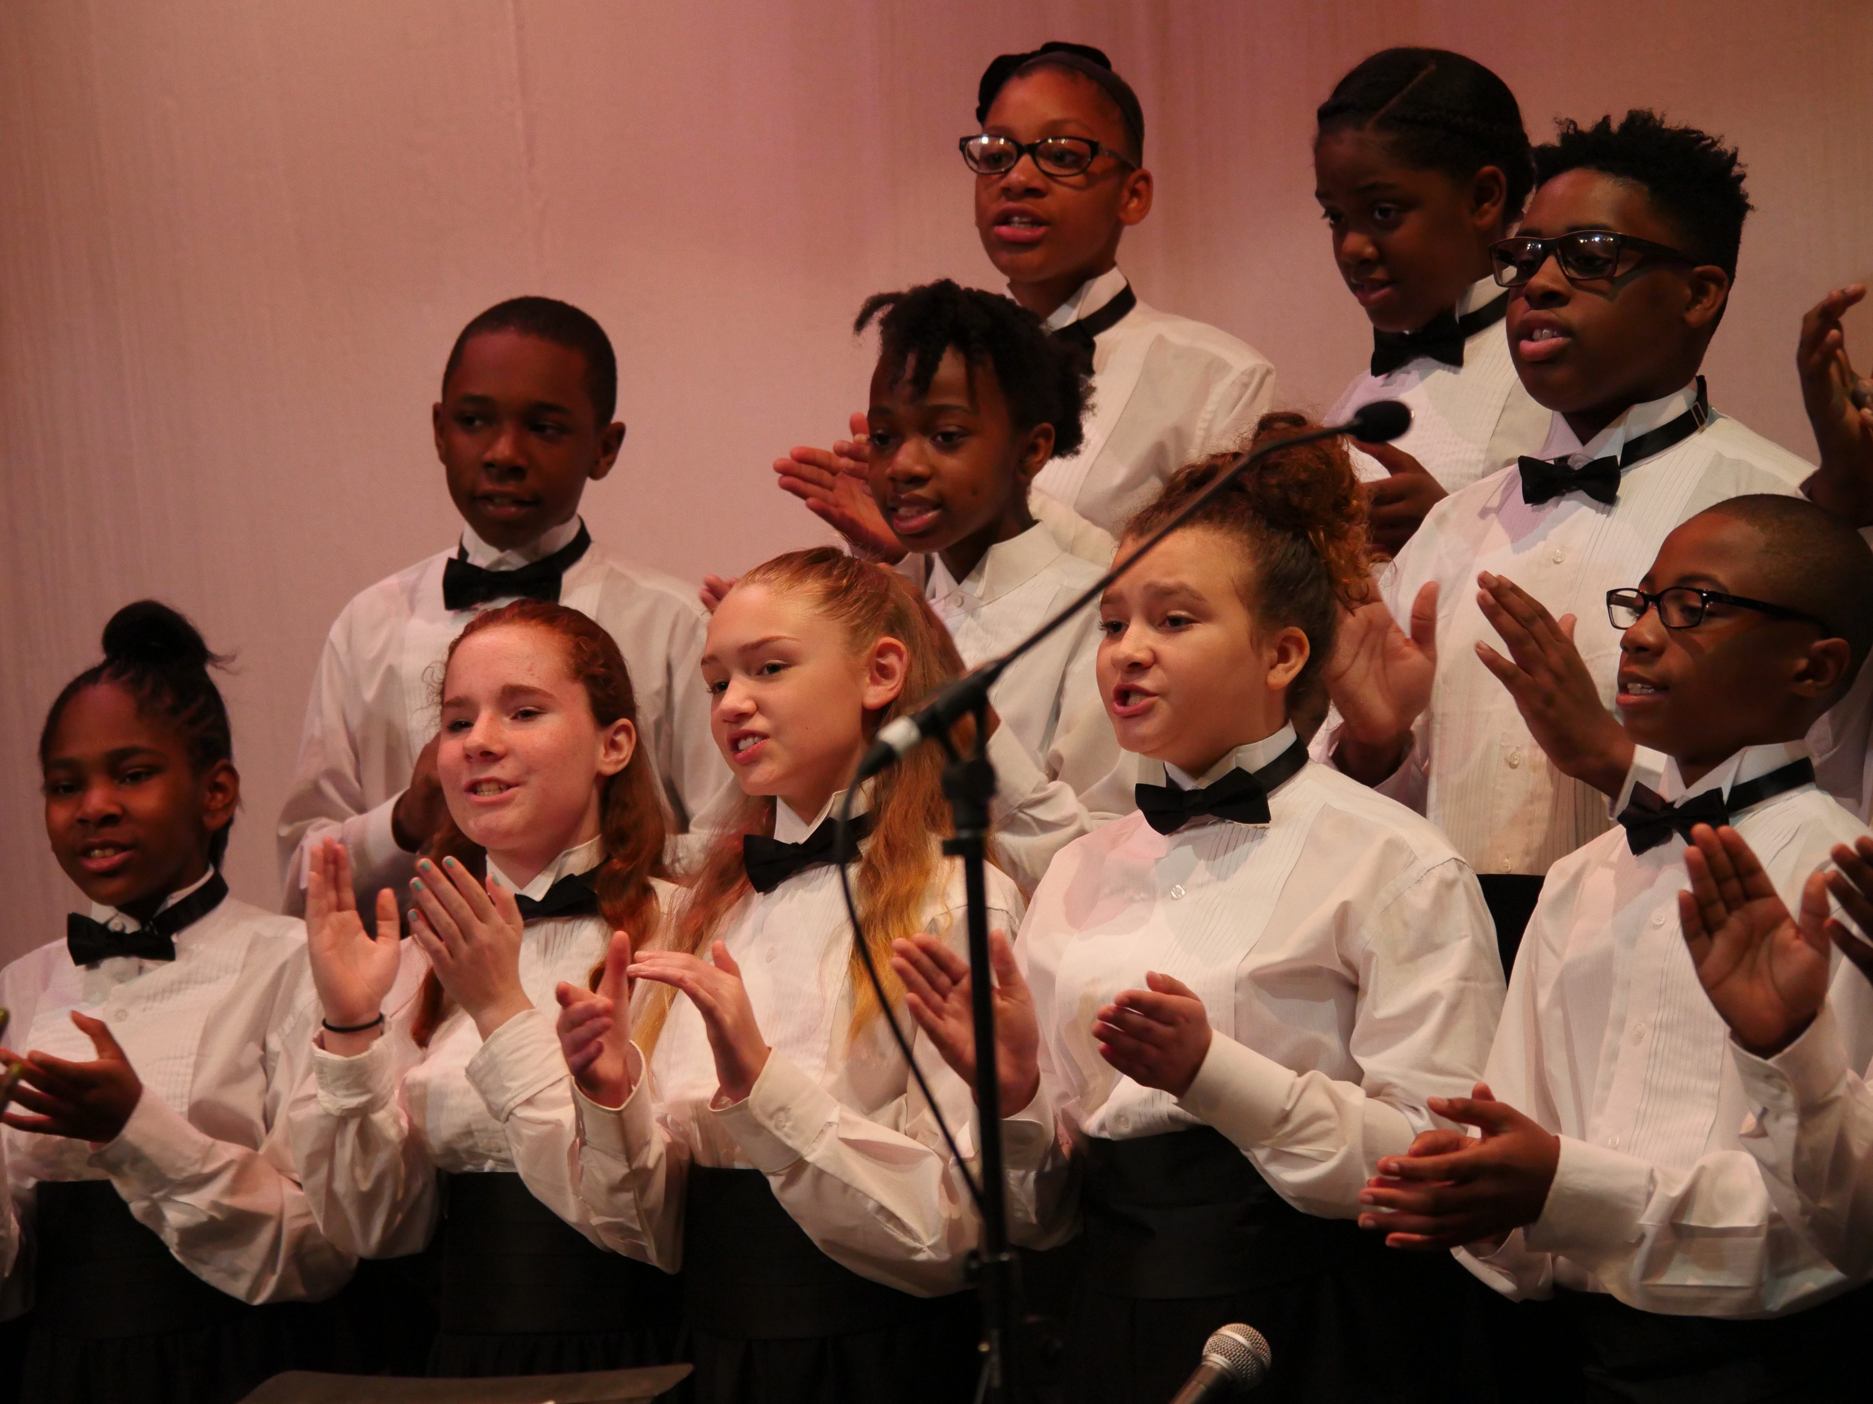
We are all on the same team with the same goal – to provide the best for students

Slide 3
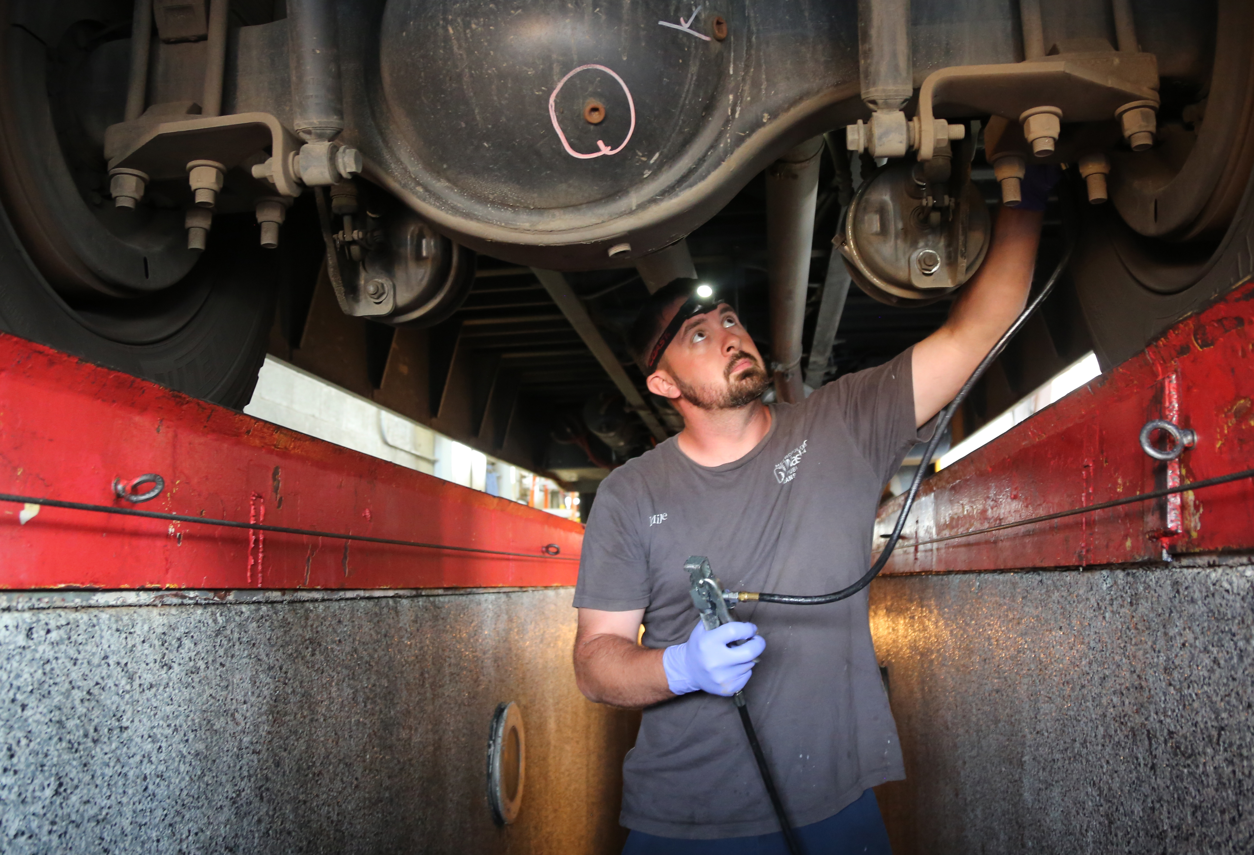
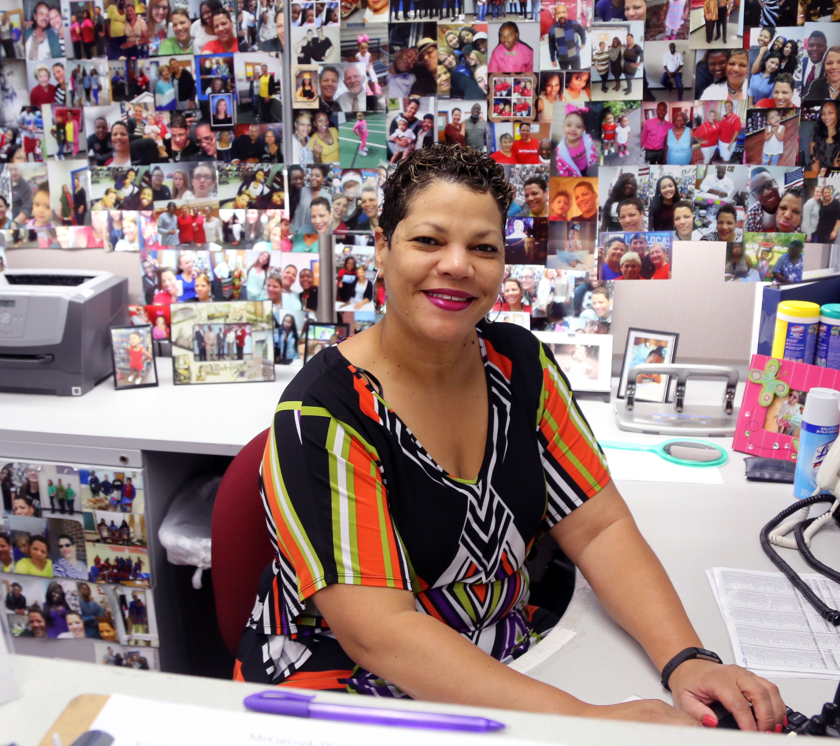
What Should be Simple Really Isn’t!

Slide 4
The Challenge
Media and community needs consume majority of resources and time
Diverse employee groups
Inadequate planning or lead time resulting in employees hearing important information in media or via rumor mill rather than leadership
And so on, and so on, and so on…
(Insert your district’s challenge here!)

Slide 5
Focus on internal communications in Metro Nashville Public Schools
Stop Assuming and Ask
Focus Groups
Surveys
How can we make employee communications more appealing?
45% - job specific
How do they prefer to receive information?

Slide 6
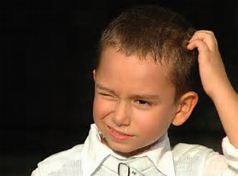
90% Prefer Email

Slide 8
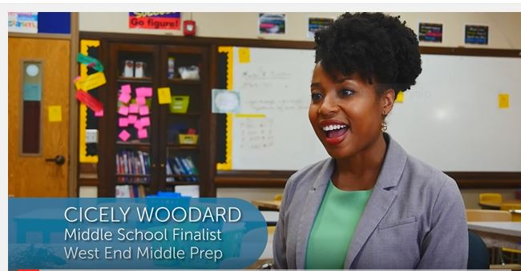
Celebrate employees

Slide 9
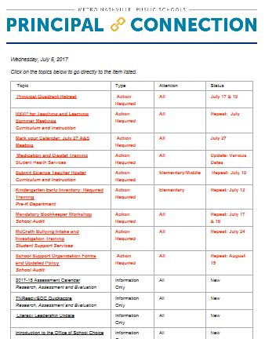
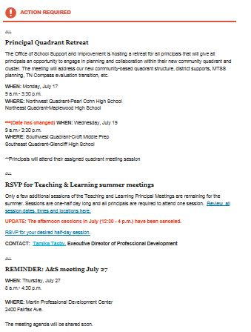
Targeted Emails

Slide 10
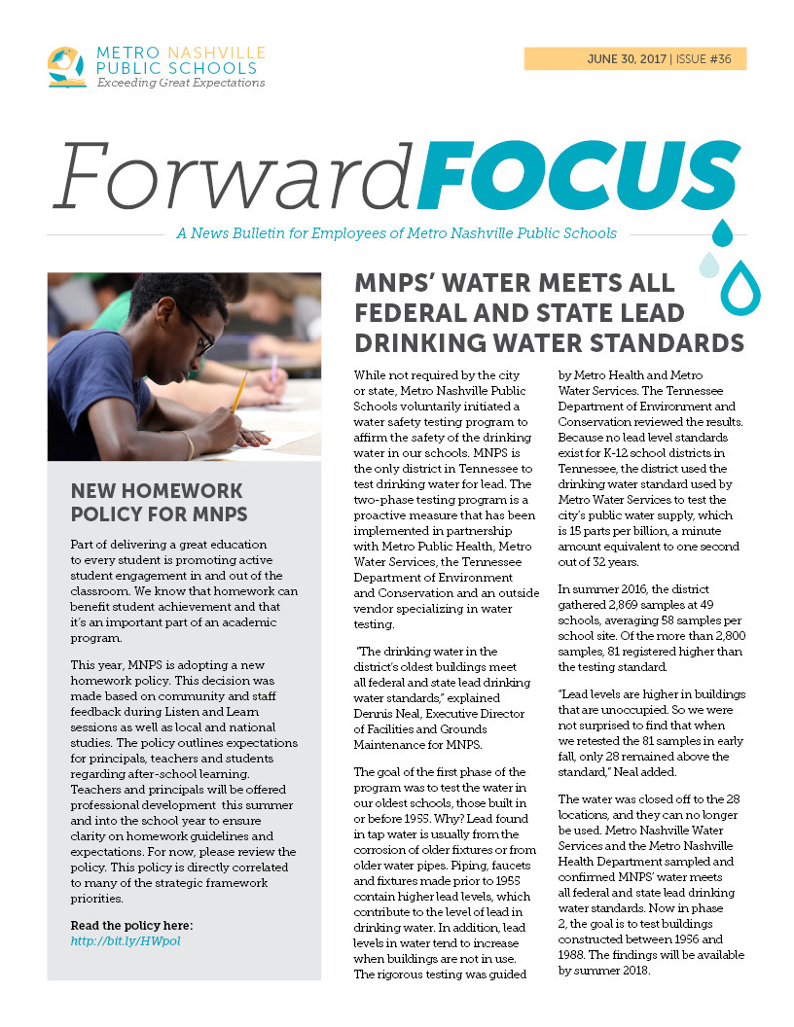
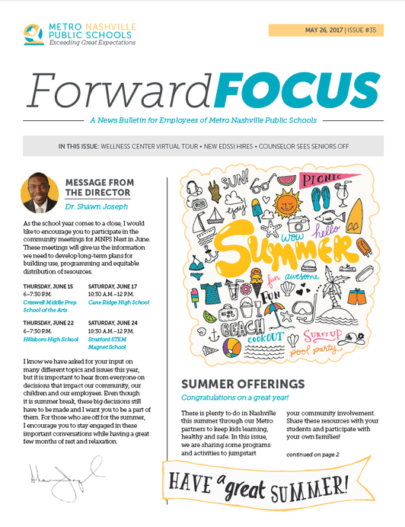
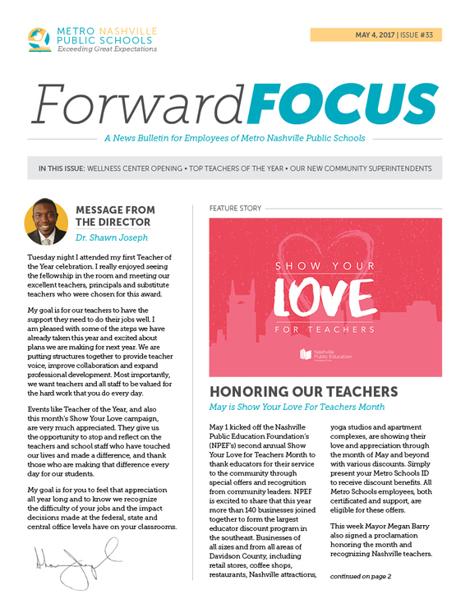
Employee Newsletter

Slide 11
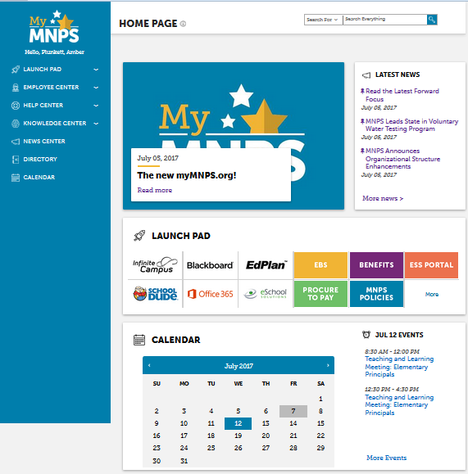
Revamped Intranet

Slide 12
Goals behind the Strategy:
Employees hear from us first
The information they need is easy to find and understand
Inclusive of all employees – no matter position, pay grade or work schedule
Knowledgeable staff
One team, shared vision

Slide 13
How are we doing?
Principal Connection
95% say Principal Connection email helps them stay informed and organized.
“I appreciate the time and effort that is put into the PC each week. I use it to build my TO DO LIST for the following week.”
“Great first year! I am looking forward to seeing this become more permanent, consistent and an embedded procedure for our communication plans.”

Slide 14
How are we doing?
Forward Focus
Mid-year survey showed 83% preferred electronic, not print
Supported our recommendation for an electronic newsletter, with much smaller quantity printed as needed
67% rated content as excellent or good

Slide 15
Tools
Jotform
Submissions- allows attachments
Sharepoint
Intranet site – brand new
Emma
Allows us to target and measure open rates. Tiered account allows us to share tool with schools and departments

Slide 16
Share:
What’s working in your district?

Slide 17
Olivia Brown
Director of Communications
Olivia.Brown@mnps.org
615-256-8406

